Slide 1
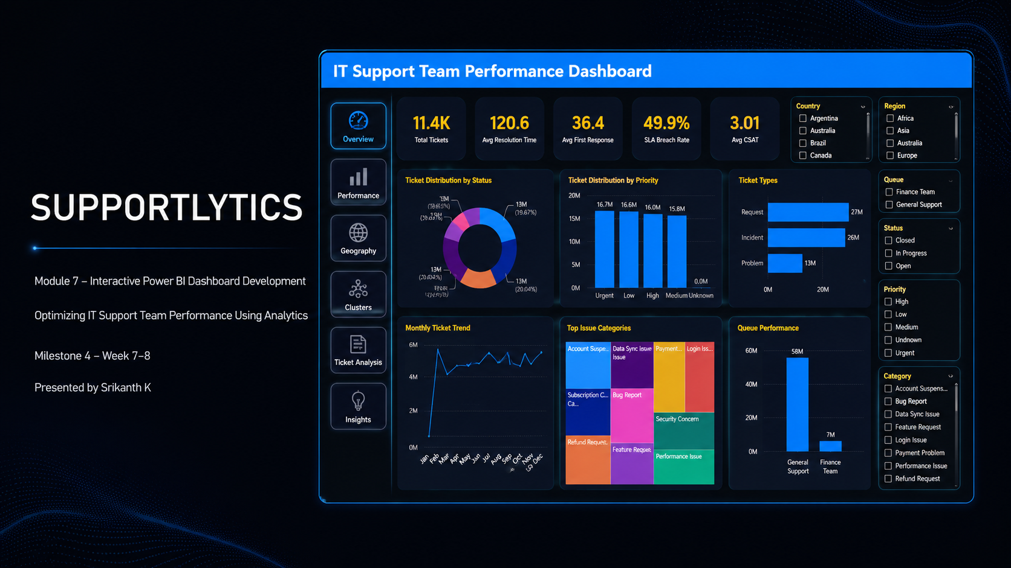
SUPPORTLYTICS
Module 7 – Interactive Power BI Dashboard Development
Optimizing IT Support Team Performance Using Analytics
Milestone 4 – Week 7–8
Presented by Srikanth K

Slide 2

Module 7 – Dashboard Development Objectives
Data
Analysis
Visualization
Power BI
Integrate Analytical Outputs
Build Interactive Power BI Pages
Combine performance, geographic, ticket and cluster analysis into a unified dashboard
Enable dynamic exploration of support performance across six analytical views
Organize Key KPIs
Deliver Actionable Visual Insights
Average Resolution Time, Most Frequent Categories, Cluster Similarity Index, Top Performing Regions
Identify performance gaps, compare regions, understand workload, evaluate cluster behavior

Slide 3
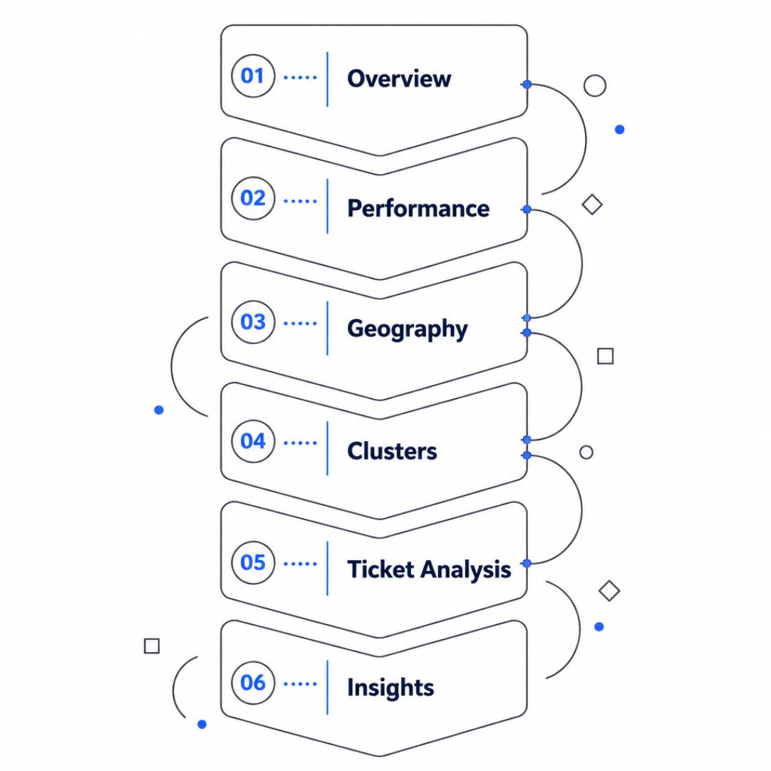
Dashboard Architecture & Navigation
Overview
Performance
Support health, ticket volume, resolution performance, SLA metrics
Resolution time by priority, queue, type, country; service-level analysis
Geography
Clusters
Global ticket distribution, regional concentration, geographic performance
Similarity scores, cluster size, performance, ticket volume patterns
Ticket Analysis
Insights
Type distribution, category frequency, priority workload, queue performance
Executive KPIs, top performers, areas requiring attention

Slide 4
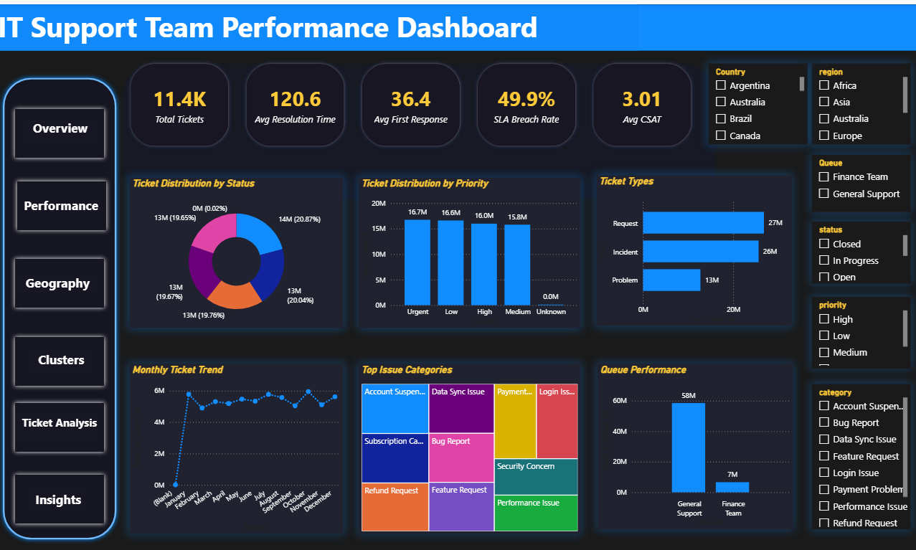

Dashboard Page 1 – Overview
PURPOSE High-level view of IT support workload and service performance, providing an immediate snapshot before deeper analysis.
KPIS
Total Tickets
Average Resolution Time
First Response Time
SLA Breach Rate
AVG CSAT
VISUALIZATIONS
Ticket status distribution & priority distribution
Ticket types & monthly trends
Top categories & queue performance
Purpose: Immediate snapshot of overall support health before deeper analysis.

Slide 5
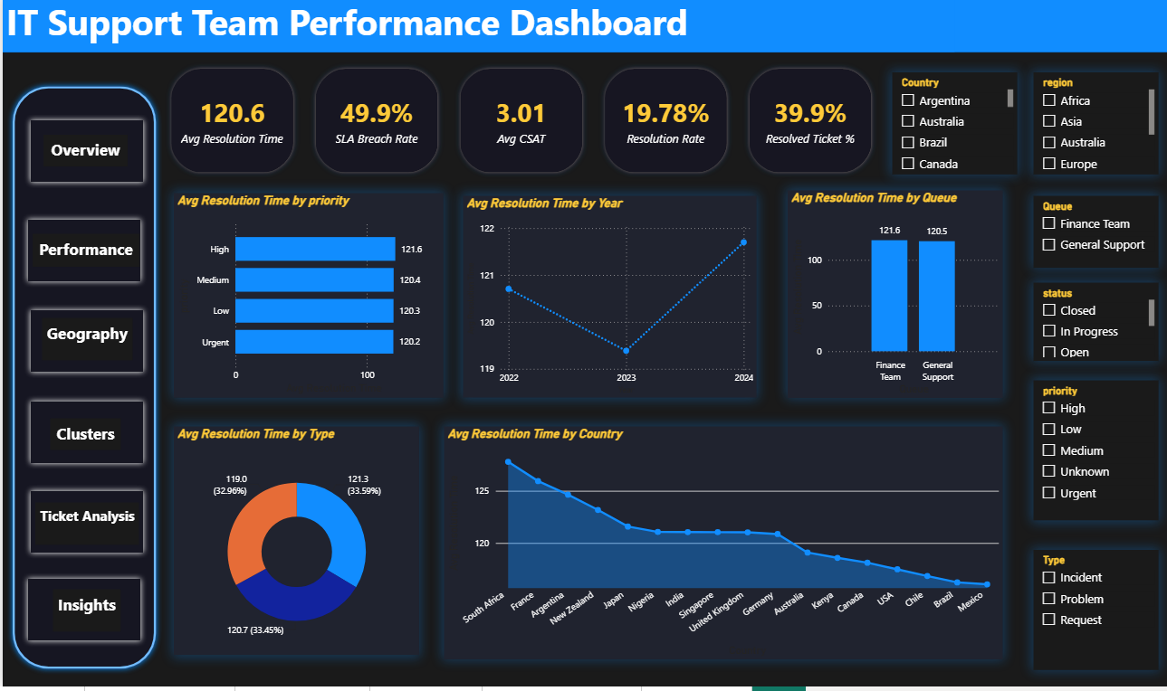
Dashboard Page 2 – Performance Analysis
PURPOSE Evaluates IT support resolution efficiency and service performance across multiple operational dimensions.
KPIS
Average Resolution Time
SLA Breach Rate
Resolution Rate
Resolved Ticket %
CSAT
VISUALIZATIONS
Resolution time by priority
Year-over-year trends
Queue efficiency
Ticket type performance
Country-level comparison
Interactive filters: Country, Region, Queue, Priority, Status enable comparative performance analysis.

Slide 6
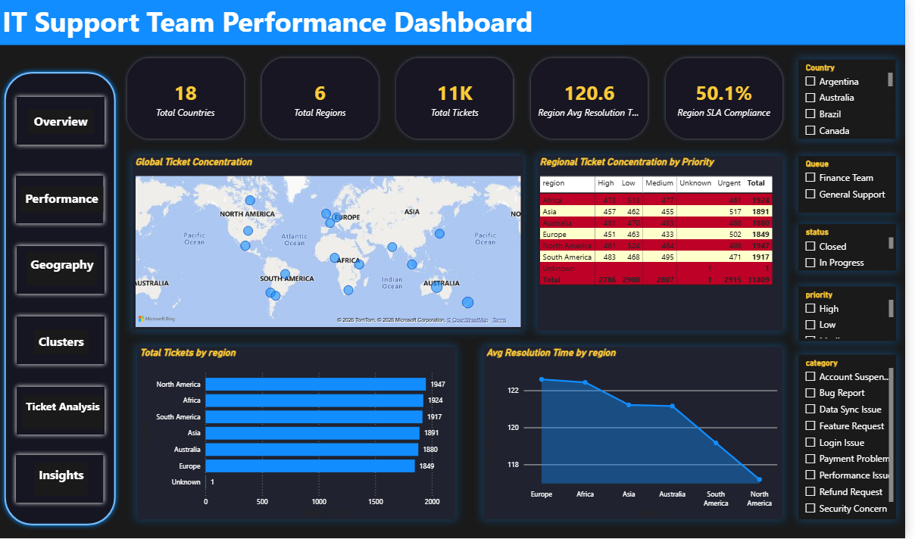
Dashboard Page 3 – Geographic Analysis
PURPOSE Analyzes global and regional ticket distribution to identify geographic workload patterns and compare regional support performance.
KPIS
Total Countries
Total Regions
Total Tickets
Regional Average Resolution Time
Regional SLA Compliance
VISUALIZATIONS
Global ticket concentration map
Regional priority distribution
Tickets by region
Resolution time by region
Enables country-level performance comparison and geographic priority analysis across all regions.

Slide 7
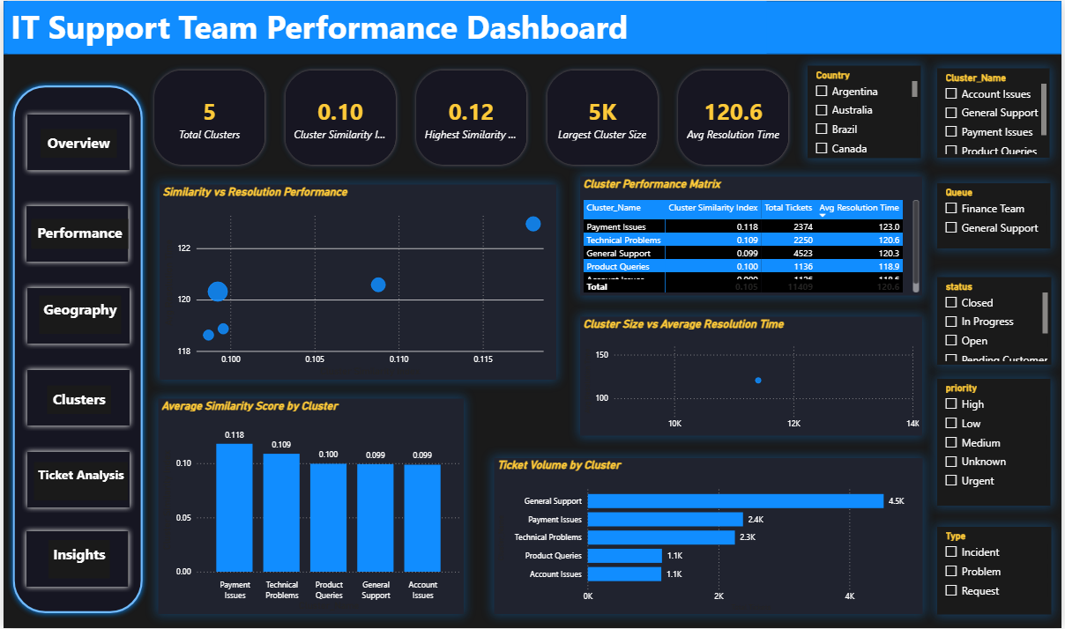
Dashboard Pages 4– Cluster Analysis
PURPOSE Analyzes support ticket clusters to identify similar issue groups, compare their workload and evaluate resolution performance.
KPIS
Total Clusters
Cluster Similarity Index
Highest Similarity Score
Largest Cluster Size
Average Resolution Time
VISUALIZATIONS
Similarity vs resolution performance
Cluster performance matrix
Similarity score by cluster
Cluster size vs resolution time
Ticket volume by cluster
Dashboard Role: Identifies patterns among similar support issues and highlights high-volume clusters that require closer performance analysis.

Slide 8
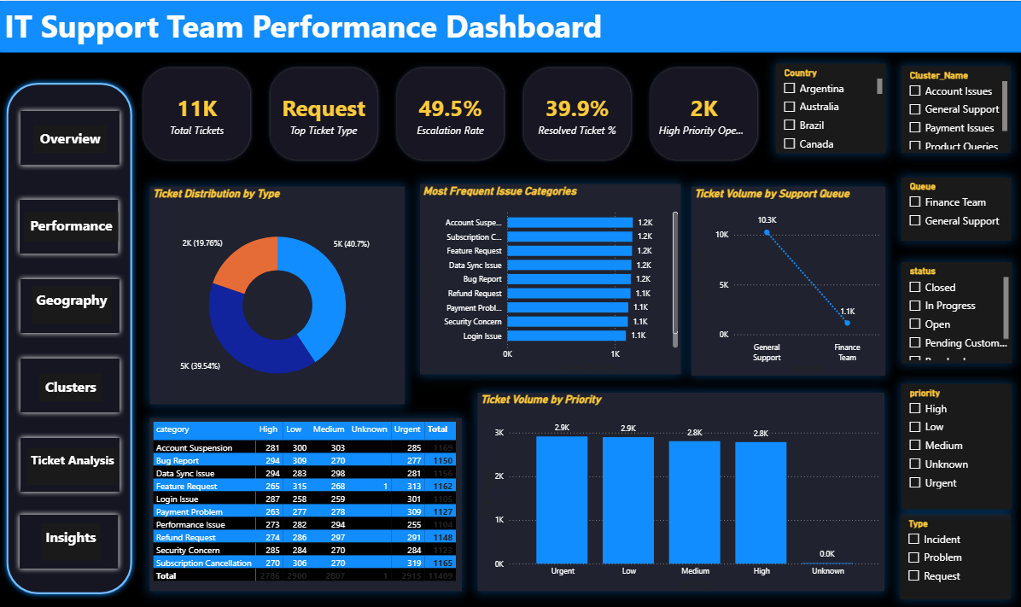
Dashboard Pages 5– Ticket Analysis
PURPOSE Provides a detailed view of ticket composition, issue categories, workload distribution and priority patterns to understand support demand.
KPIS
Total Tickets
Top Ticket Type
Escalation Rate
Resolved Ticket %
High Priority Open Tickets
VISUALIZATIONS
Ticket distribution by type
Most frequent issue categories
Ticket volume by support queue
Category × priority analysis
Ticket volume by priority
Dashboard Role: Identifies major ticket patterns, high-volume issue categories and priority areas requiring attention.

Slide 9
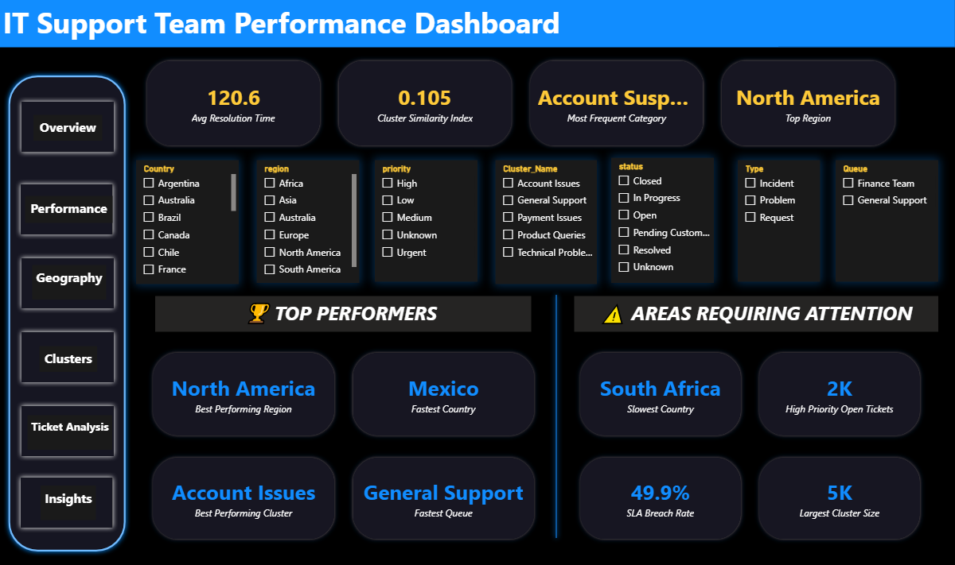
Dashboard Page 6 – Executive Insights
PURPOSE Consolidates key findings into actionable insights by highlighting top performers and areas requiring attention.
KPIS
Avg Resolution Time
Cluster Similarity Index
Most Frequent Category
Top Region
INSIGHT AREAS
⚠️ Areas Requiring Attention
🏆 Top Performers
Slowest Country
High Priority Open Tickets
SLA Breach Rate
Largest Cluster Size
Best Performing Region
Fastest Country
Fastest Queue
Best Performing Cluster
Dashboard Role: Transforms analytical results into concise performance insights for quick decision-making and operational review.

Slide 10

Module 7 – Dashboard Development Completed
Dashboard Deliverables
Key Dashboard KPIs
✓ Interactive Power BI dashboard
✓ Six analytical dashboard pages
✓ KPI-driven performance monitoring
✓ Geographic and country-level analysis
✓ Cluster and similarity analysis
✓ Ticket and category analysis
✓ Interactive slicers and filtering
✓ Executive-level insights summary
Analytical outputs from previous modules were integrated into an interactive Power BI dashboard, enabling performance monitoring, geographic comparison, cluster analysis, ticket workload analysis, and executive-level insight discovery.
Module 7 successfully converts analytical findings into an interactive decision-support dashboard.
Average Resolution Time
Most Frequent Categories
Cluster Similarity Index
Top Performing Regions

Slide 11
THANK YOU

